Slide 1

WEATHER WEBSITE
TEAM MEMBERS:-
RAJAT AGRAWAL
PRIYESH TRIPATHI
PRADUMN DUBEY
PROJECT GUIDE:-
MR.GAURAV SINGH RAWAT

Slide 2
CONTENT
PROBLEM INTRODUCTION
PROJECT OBJECTIVE
SCOPE OF PROJECT
S/W & H/W REQUIREMENTS

Slide 3
PROBLEM
INTRODUCTION

Slide 4
WHY THIS IS IMPORTANT TO US ?
1) Weather controls the distribution of rain water on earth. All living organisms on earth require liquid water to survive, and humans require fresh (not salty) water for drinking and agriculture (growing crops for food). ... There are many ways that weather is important inpeople's lives;
Weather warnings are important forecasts because they are used to protect life and property. Forecasts based on temperature and precipitation are important to agriculture, and therefore to traders within commodity markets. Temperature forecasts are used by utility companies to estimate demand over coming days.
2)Weather warnings are important forecasts because they are
used to protect life and property. Forecasts based on
temperature and precipitation are important to agriculture,
and therefore to traders within commodity markets.
Temperature forecasts are used by utility companies to
estimate demand over coming days.

Slide 5
PROJECT OBJECTIVE
The weather project aim is to analyse the economic costs of more frequent and more extreme weather events on transport and on the wider economy and explores adaptation strategies for reducing them in the context of sustainable policy design.
The main Objective is to provide the relevant information to the common people so that they can plan their actions accordingly and protect themselves from weather hazards.

Slide 6
SCOPE OF THE PROJECT
In this project you will conduct an investigation on local and world weather and climate. To complete your investigation, you will have at your disposal detailed instructions that describe how to create weather instruments, how to access the Internet to locate real-time weather information from around the world, and this online educational project to guide you along .
Specifically, students will : develop a basic understanding of how weather can be described in measurable quantities, such as temperature, wind and precipitation use hands-on activities and real-time data investigations to study factors that affect weather and climate.

Slide 7
Software & Hardware Requirements

Slide 8

TECHNOLOGY & SOFTWARE
The common instruments of measure are anemometer, wind vane, pressure sensor , thermometer, hygrometer, and rain gauge. The weather measures are formatted in special format and transmit to WMO to help the weather forecast model.
Weather APIs
Javascript
HTML ,CSS
HARDWARE:-
Any supporting operating system .
Internet connection

Slide 9
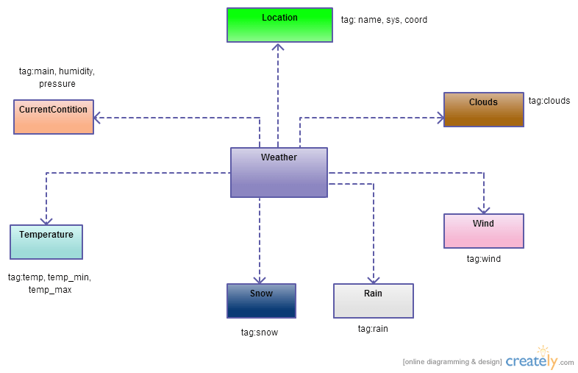
CLASS DIAGRAM

Slide 10
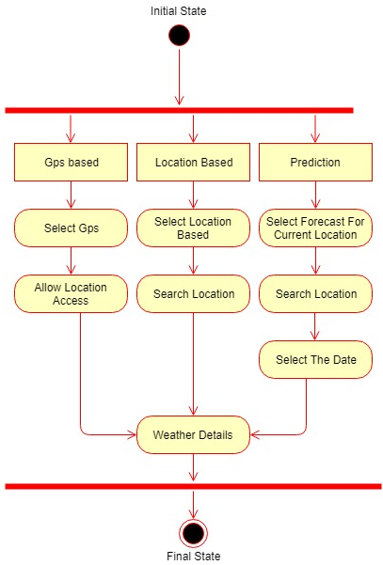
ER DIAGRAM

Slide 11
  DIFFERENT WEATHER DATA BASE
    Historical Weather Data
    Real-Time Weather Data
    Local Weather Data
    Global Weather Data
  Air Quality Index
  Climate Data
  Pollen Data
  Wildfires Data
  Marine Data
  Land Use Data
  Water Data
  Geological Data
  Surface Data
  Atmosphere Data
  Thermosphere Data

Slide 12
DIFFERENT DATABASES OF WEATHER WEBSITE
OpenWeatherMap API
Weatherbit API
AccuWeather API
Dark Sky API
Weather2020 API
ClimaCell API
Visual Crossing API
OpenWeather Map API
Weather bit API
AccuWeather API
Dark Sky API
Weather2020 API
ClimaCell API
Visual Crossing API

Slide 13
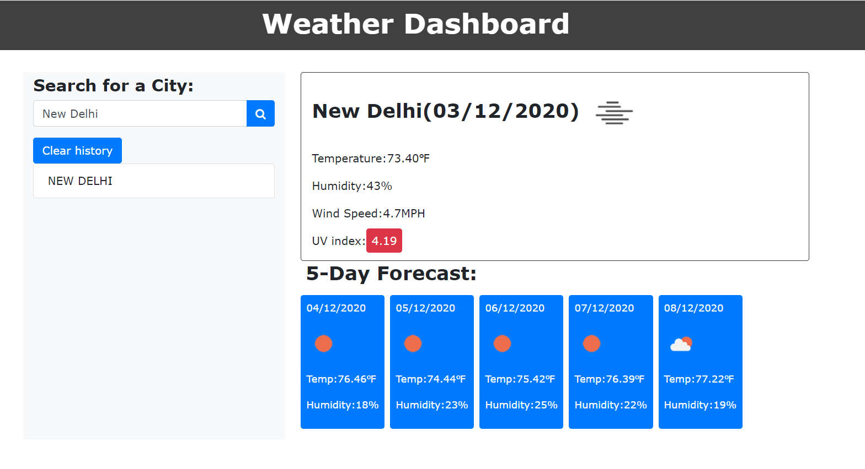
Demonstration of Working Model of Project

Slide 14
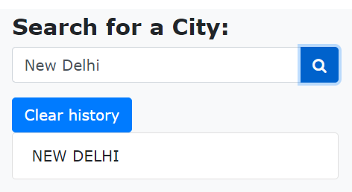
Here the user will enter the city name for which the weather data is required.
After entering the city name click here to get the rquired data.

Slide 15
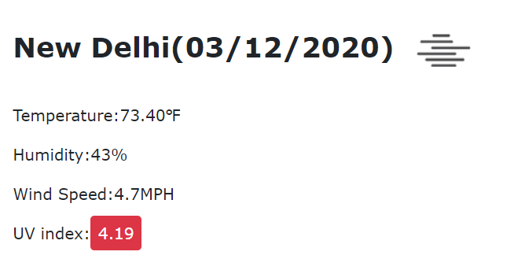
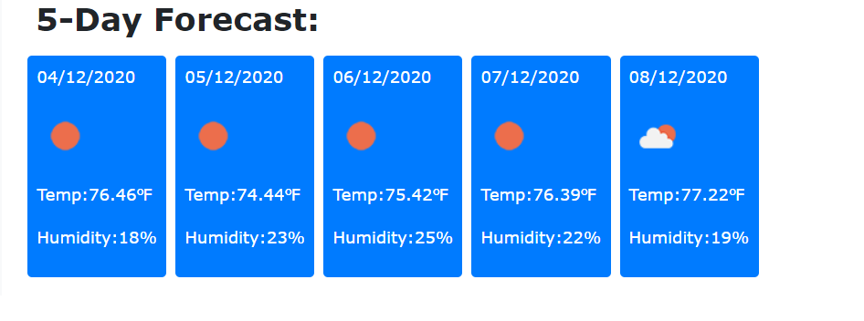
On pressing the enter/search button the user will get the current weather info of the city entered.
Besides the current weather info, the user will also be able to see the next 5-days forecast.

Slide 16
Here user can also see the cities which have been searched earlier by him/her.
Through this Clear History button user can delete the previously searched cities.

Slide 17
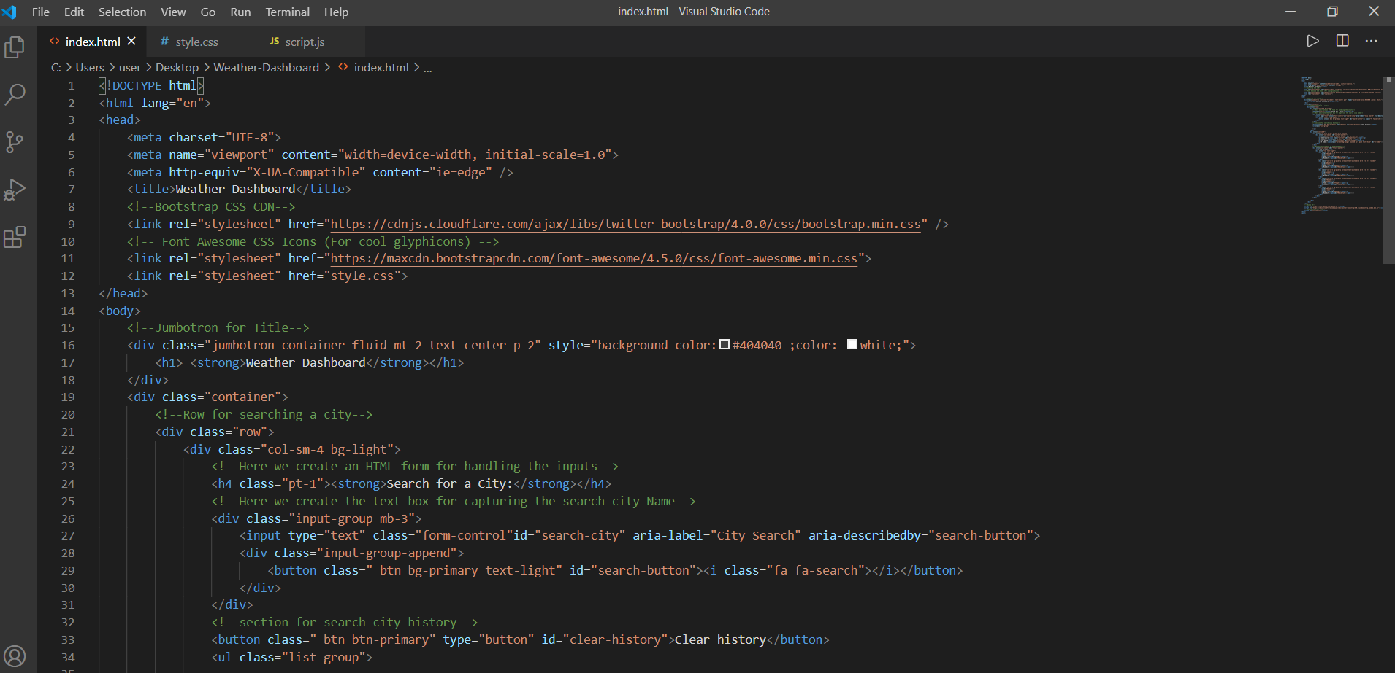
Here are some snaps of the code of the website

Slide 18
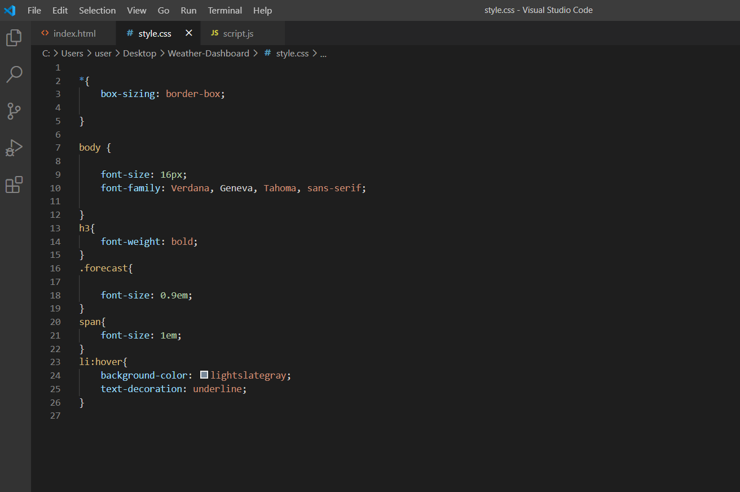

Slide 19
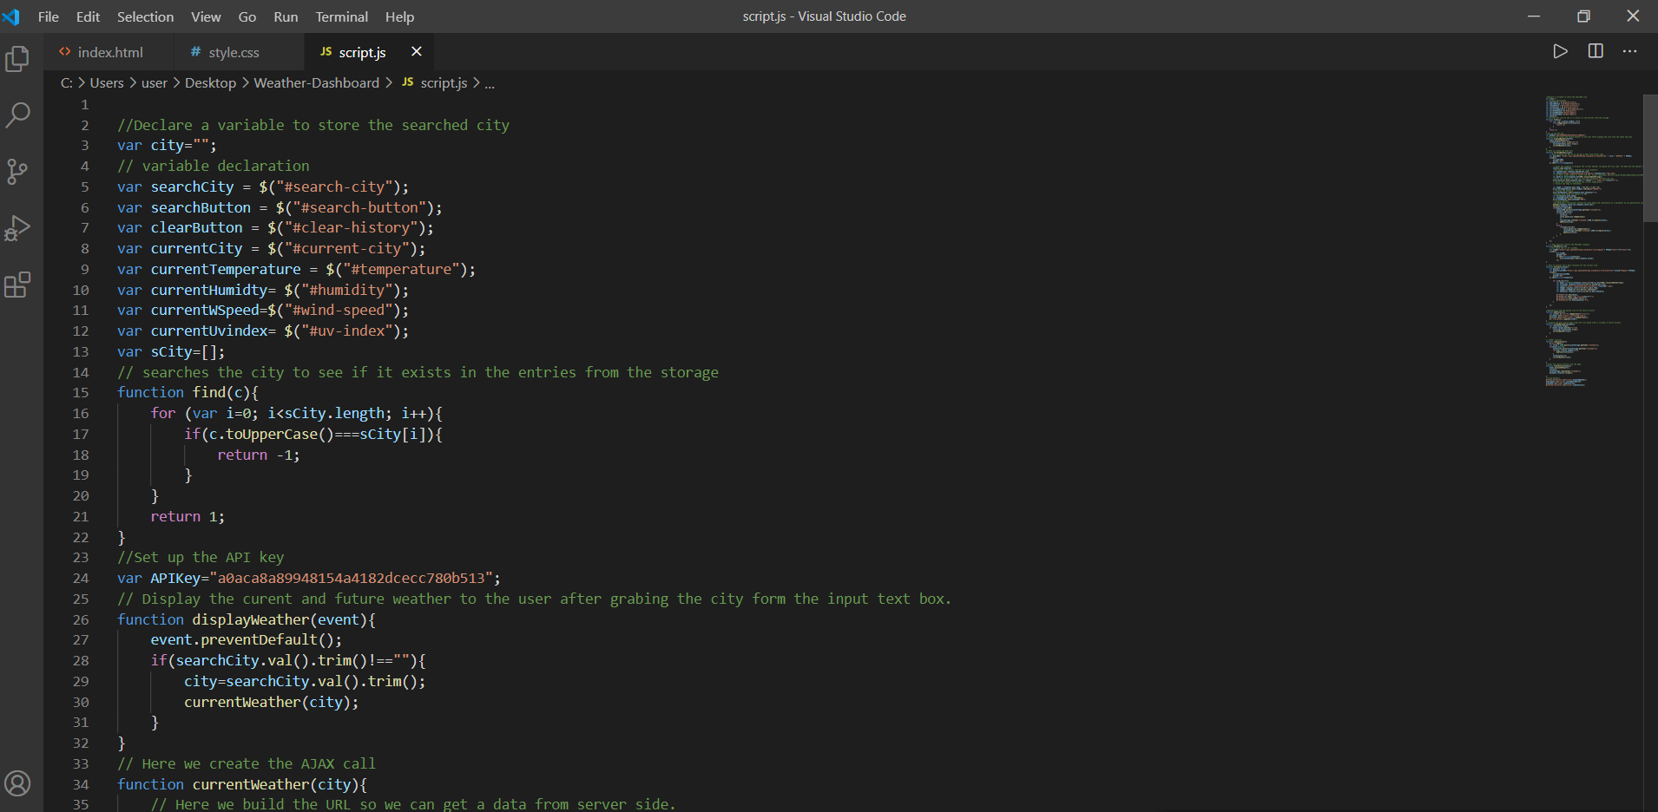

Slide 20
THANK
YOU

